Slide 1
Review
What are the functions of the following organelles?
  Cell membrane
  Mitochondria
  Golgi body
  Vesicle
  Ribosome
  Rough ER
  Smooth ER
  Lysosome
  Nucleus
  Cytoplasm

Slide 2
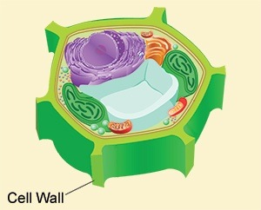
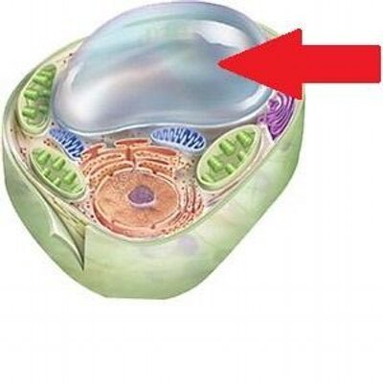
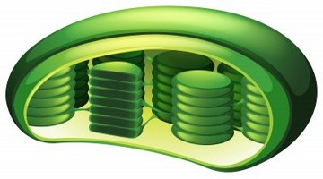
Plant Cell Organelles
What organelles do plants cells have that animal cells don’t?
  Chloroplasts
  Cell wall
  Central vacuole
What are their functions?

Slide 3
Looking at Cells
Cells can vary greatly in their size and shape.
But they are all still very small.
Just how big are cells?
Cell size is limited for a reason.

Slide 4
OBJECTIVE
Hypothesize, explore, and understand why cells are SO small, yet can perform life functions.
Compare cells and determine their relative sizes and shapes.
Make connections between cell form (it’s shape) and the functions it performs.

Slide 5
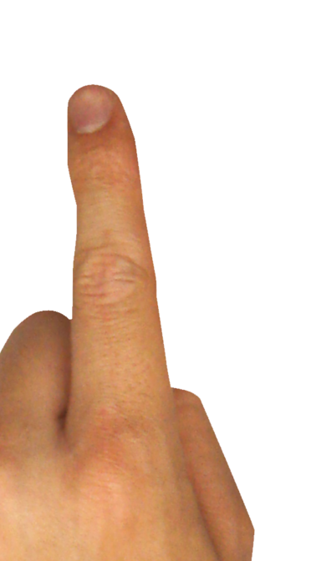
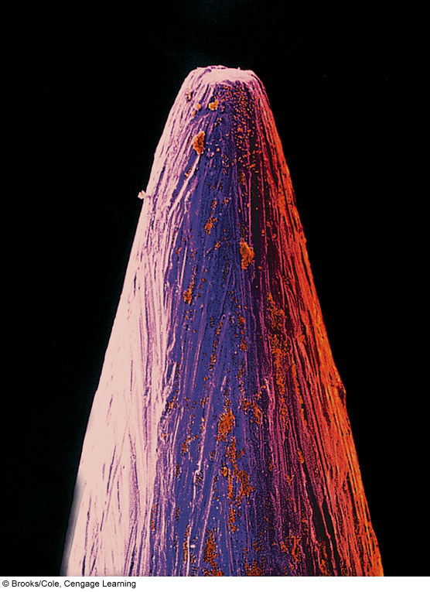
This is the business end of a needle.
This one’s infested with E. coli.
Finger width
= 16mm
Bacteria
200µm = 0.2mm
Fig. 4-2a, p. 54
Notes:
Figure 4.2
Rod-shaped bacterial cells on the tip of a household pin, shown at increasingly higher magnifications (enlargements). The “μm” is an abbreviation for micrometers, or 10^{–6} meters.
Figure It Out: About how big are these bacteria?
Answer: About 1 μm wide, and 5 μm long

Slide 6
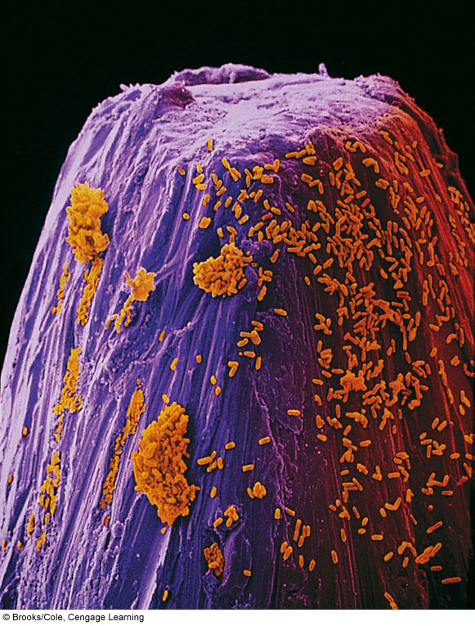

40µm = 0.04mm
Fig. 4-2b, p. 54
Notes:
Figure 4.2
Rod-shaped bacterial cells on the tip of a household pin, shown at increasingly higher magnifications (enlargements). The “μm” is an abbreviation for micrometers, or 10^{–6} meters.
Figure It Out: About how big are these bacteria?
Answer: About 1 μm wide, and 5 μm long

Slide 7
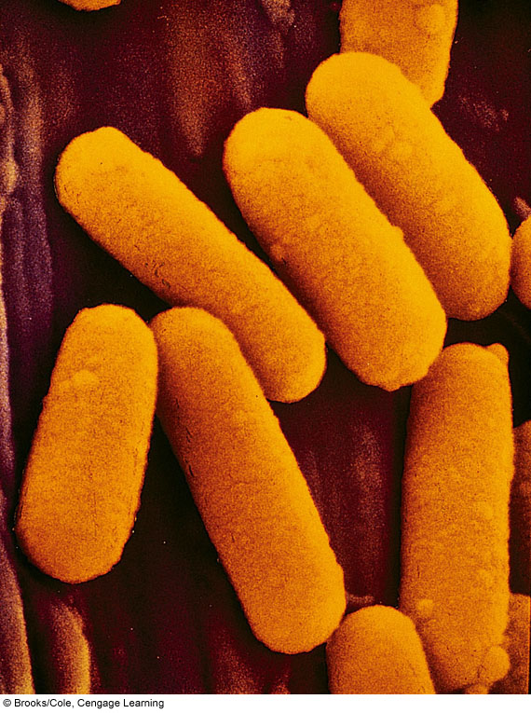
1µm = 0.001mm
Fig. 4-2c, p. 54
Notes:
Figure 4.2
Rod-shaped bacterial cells on the tip of a household pin, shown at increasingly higher magnifications (enlargements). The “μm” is an abbreviation for micrometers, or 10^{–6} meters.
Figure It Out: About how big are these bacteria?
Answer: About 1 μm wide, and 5 μm long

Slide 8
Why Are cells so small?

Slide 9
Why Are Cells So Small?
Fact: Cells stay small because they are more efficient at taking in the stuff they need and removing the stuff they don’t if they’re small.
WHY ARE THEY
SO SMALL???

Slide 10

Think of a Cell as a Protein Factory
PROTEINS
Amino acids, sugars, lipids
WASTE

Slide 11

Looking at Cells
Cells are spectacular machines.
They are both individual power factories and collective cogs, working together to perform magnificent functions.
In order to work properly, they must have fuel, such as sugar, and other materials and must be able to remove waste.
The entrance of needed materials and removal of unwanted waste must be & is regulated.
The efficiency of this regulation is helped out by the cell being so small.

Slide 12
Looking at Cells
All substances that enter or leave a cell must cross the surface of the cell.
When a substance is in the cell, the work done on it happens in the volume of the cell’s interior.
So there is a relationship between the amount of surface area of the cell and the amount of volume it has.
This is called surface-area-to-volume ratio.
Cells with higher surface area-to-volume ratios can exchange substances more efficiently and effectively meaning that they perform their jobs better.

Slide 13
Looking at Cells
When comparing cells of the same shape, small cells have greater surface area-to-volume ratios than large cells.
So, why are cells so small?
Small cells function more efficiently than large cells.
Think of it like this:
For every unit of surface area, one door exists = one thing can move in or out.
For every unit of volume, one machine exists = one protein or waste can be created.
When a cell gets too large, it quickly becomes too crowded with stuff on the inside and doesn’t have enough surface area to move the stuff out.
The factory gets backed up without enough doors!

Slide 14
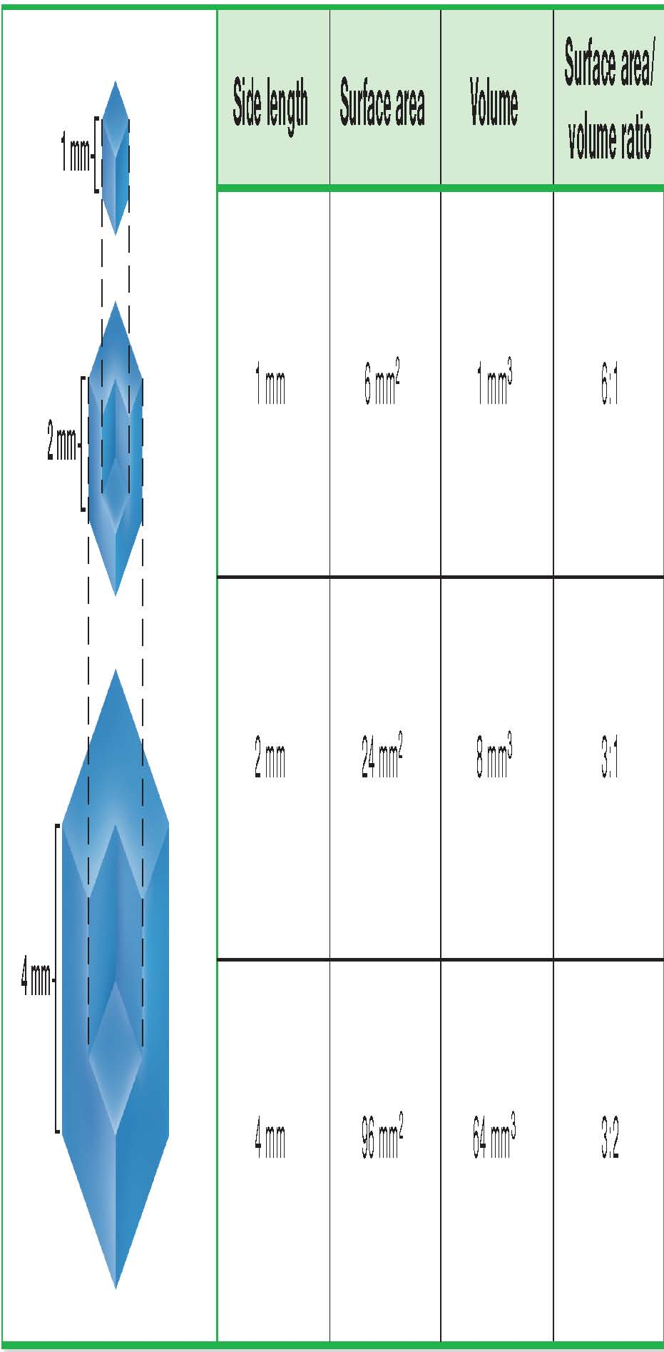
Relationship between Surface Area and Volume
Cell Surface Area to Volume Animation

Slide 15
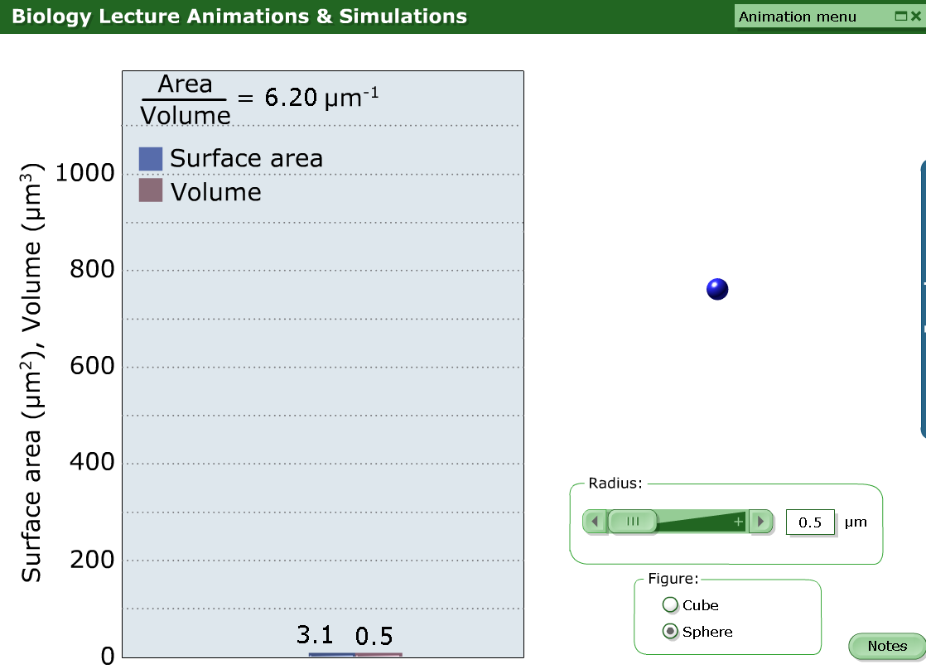

Slide 16
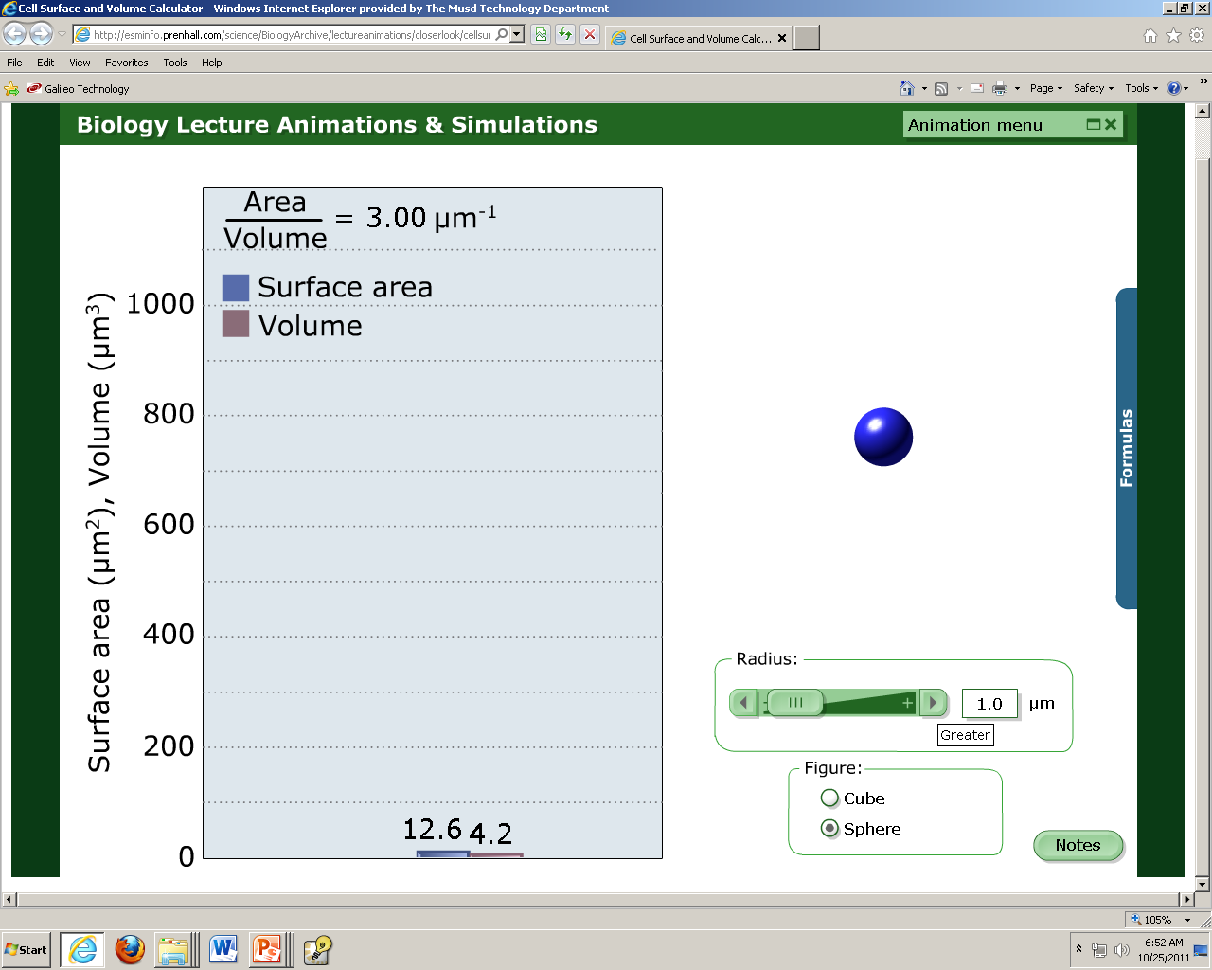

Slide 17
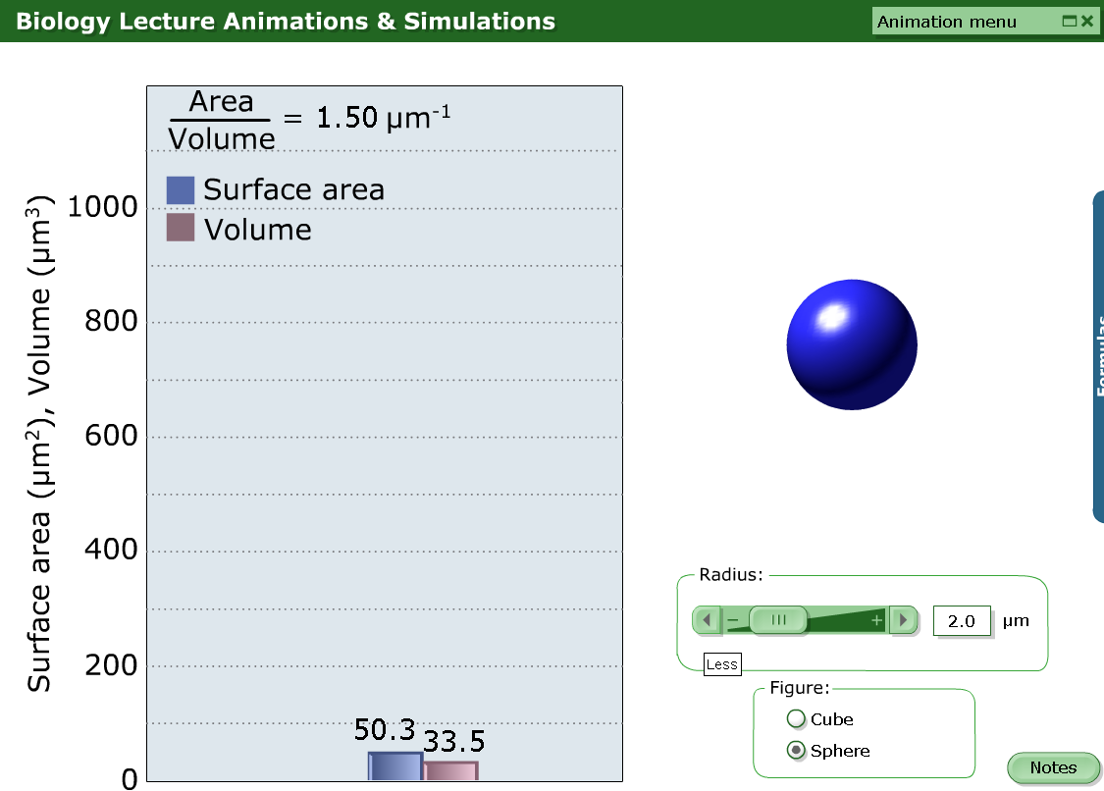

Slide 18
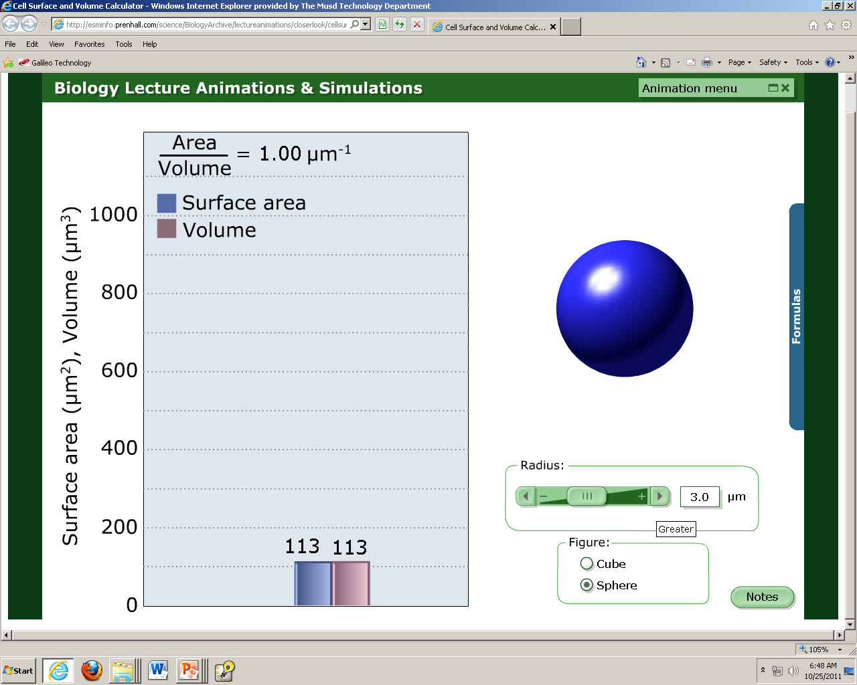

Slide 19
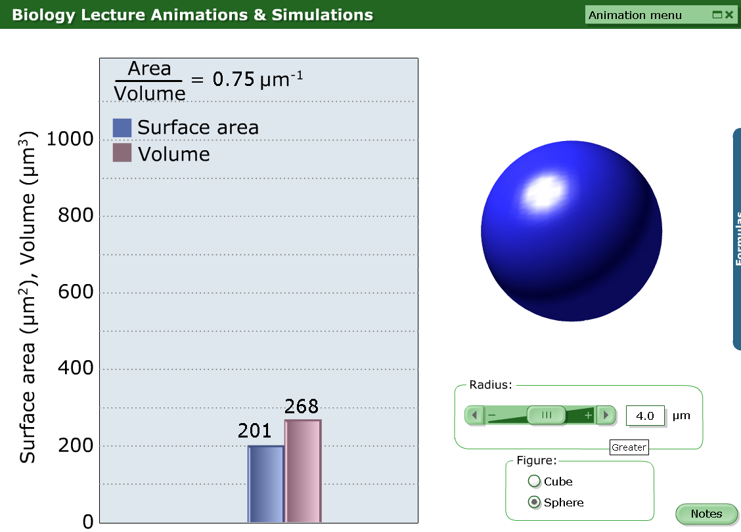

Slide 20
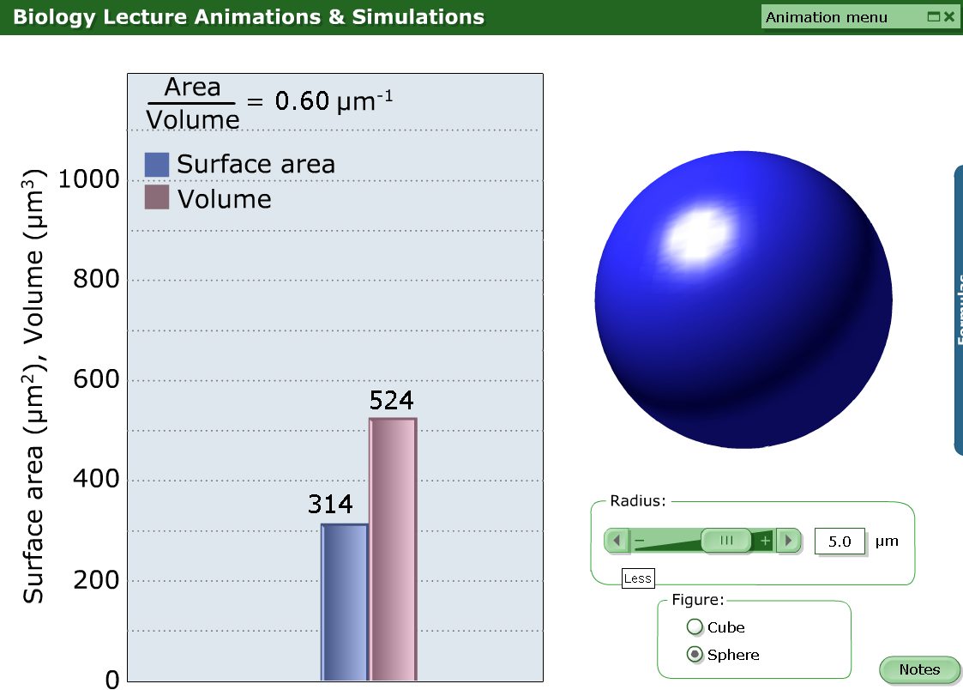

Slide 21
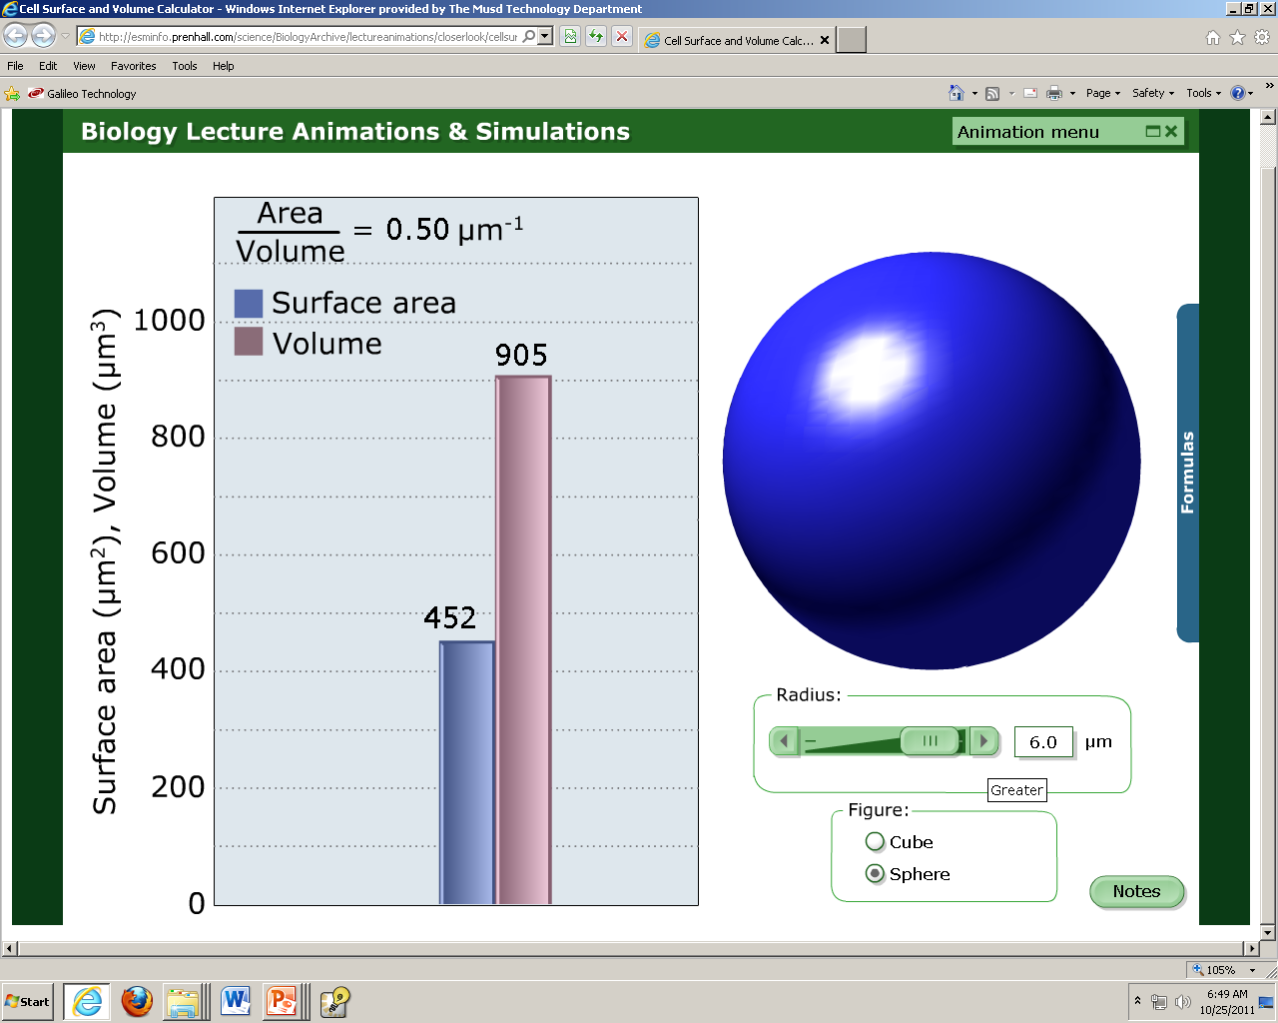

Slide 22
The Point Is…
Point is:
THE SMALLER THE CELL SIZE THE LARGER THE SA:V RATION IS!
Cells shouldn’t grow larger than having a SA:V larger than 1.
SA:V = 3
SA:V = 1
SA:V = 0.5

Slide 23
Relationship between Surface Area and Volume
How does the door to machine ratio compare.
What’s the problem as the cell becomes larger?
Cell Surface Area to Volume Animation

Slide 24

How Do You Calculate Surface Area-to-volume Ratio?
Divide surface area by the volume.
You will get a number.
  Write this number
  Add a colon
  Write the number one.
What this means is that for every one volume (machine) there is ‘x’ amount of surface area (doors)

Slide 25
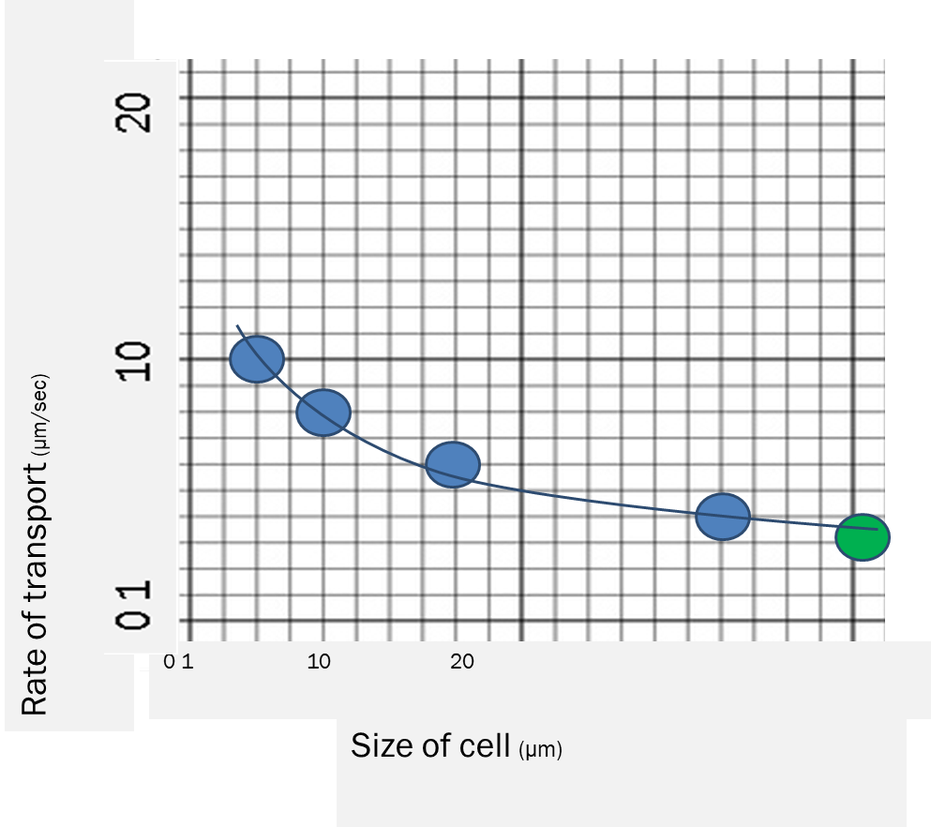
Extension Questions
What is this graph saying?
  That as the size of the cell increase, the rate od transport decreases.
What does this mean?
  The SA:V ratio (aka door to machine ratio) is more favorable when the cell is small.
The dot in green is what we could predict if the cell was 20µm big.
  About 3µm/sec

Slide 26
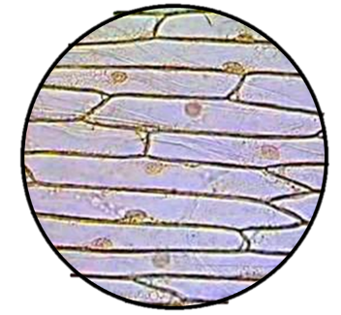
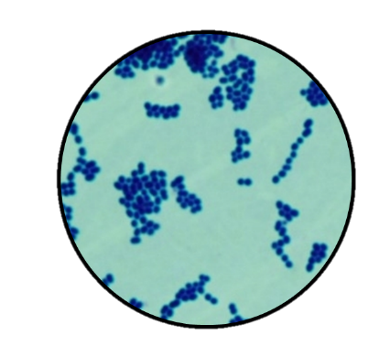
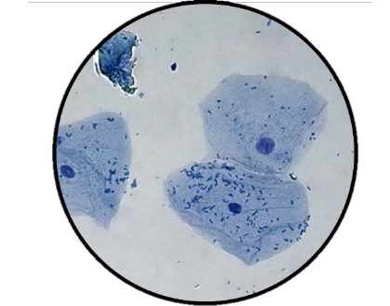
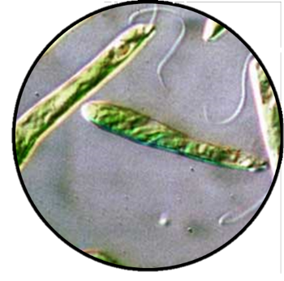
Concept check:
What type of cell is depicted in the picture?
Determine the cell type and give a minimum of 3 facts of justification. Label at least two features/organelle of each.
A
C
B
D

